Slide 1

Innopolis University
Control Theory (Linear Control)
Lecture 2
Linear Systems
Stability
Sergei Savin, PhD
Slides design by Marko Pezer & Artem Bakhanov

Slide 2
Topic of the Lecture
Linearity
Examples of Linear Systems
Stability and Asymptotic Stability
Solution for an ODE
Control Theory (Linear Control)
Slide 2

Slide 3

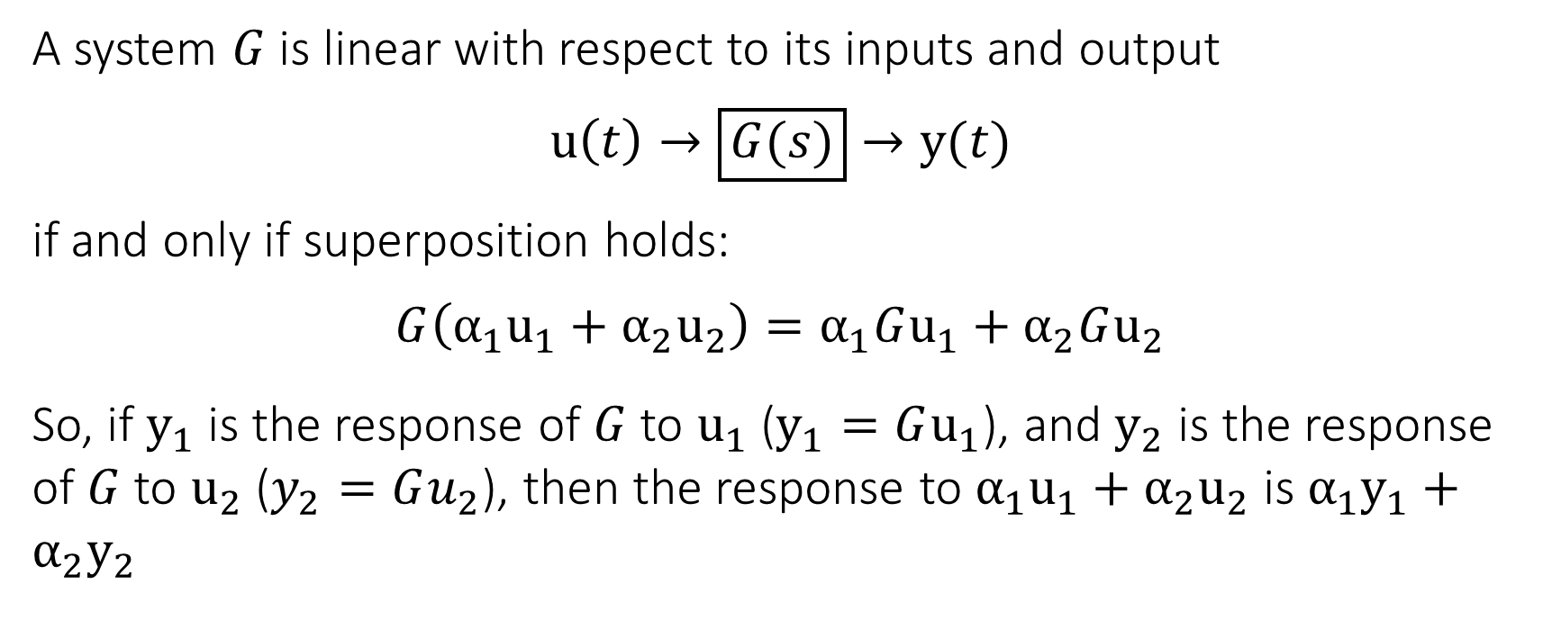
Linearity
A system $G$ is linear with respect to its inputs and output
$$u\left(t\right)→\boxed{G(s)}→y(t)$$
if and only if superposition holds:
$$G\left(α_{1}u_{1}+α_{2}u_{2}\right)=α_{1}Gu_{1}+α_{2}Gu_{2}$$
So, if $y_{1}$ is the response of $G$ to $u_{1}$ ($y_{1}=Gu_{1}$), and $y_{2}$ is the response of $G$ to $u_{2}$ ($y_{2}=Gu_{2}$), then the response to $α_{1}u_{1}+α_{2}u_{2}$ is $α_{1}y_{1}+α_{2}y_{2}$
Control Theory (Linear Control)
Slide 3

Slide 4
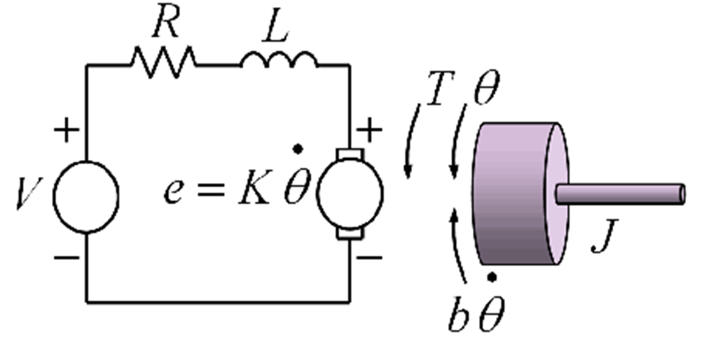
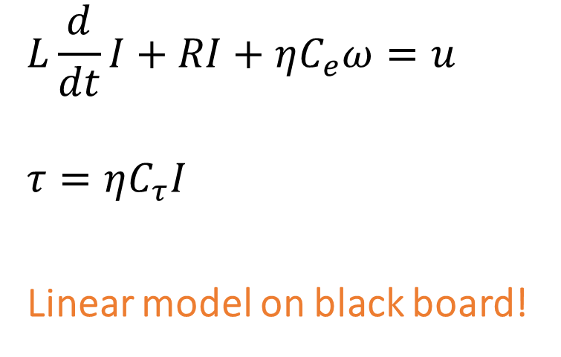
Examples of Linear Systems (1/2)
DC motor
$$L\frac{d}{dt}I+RI+ηC_{e}ω=u$$
$$τ=ηC_{τ}I$$
Linear model on black board!
Control Theory (Linear Control)

Slide 5
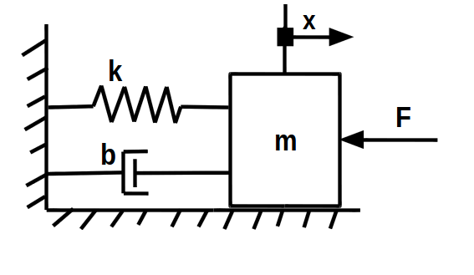
Examples of Linear Systems (2/2)
Spring-damper
Linear model on whiteboard!
Control Theory (Linear Control)

Slide 6
The Concept of Stability of a Control System
Control Theory (Linear Control)

Slide 7
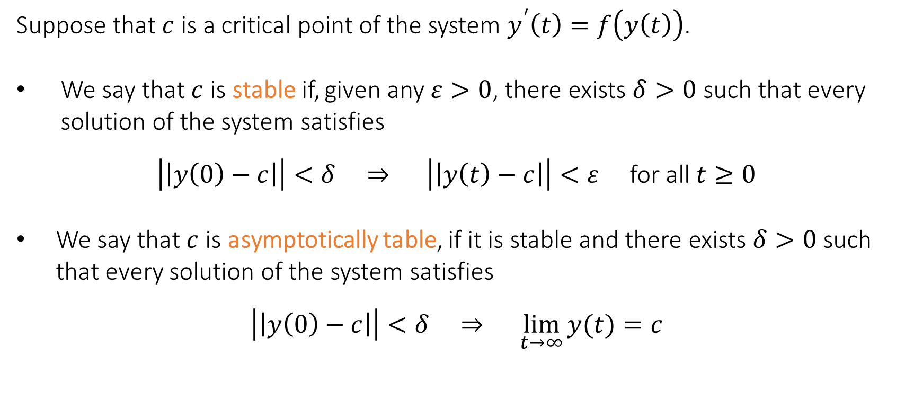
Stability and Asymptotic Stability (1/2)
Suppose that $c$ is a critical point of the system $y^{′}\left(t\right)=f\left(y\left(t\right)\right)$.
We say that $c$ is stable if, given any $ε>0$, there exists $δ>0$ such that every solution of the system satisfies
$\left|\left|y\left(0\right)−c\right|\right|<δ ⇒ \left|\left|y\left(t\right)−c\right|\right|<ε$ for all $t≥0$
We say that $c$ is asymptotically table, if it is stable and there exists $δ>0$ such that every solution of the system satisfies
$$\left|\left|y\left(0\right)−c\right|\right|<δ ⇒ \lim_{t→∞}{y(t)}=c$$
Control Theory (Linear Control)
Slide 7

Slide 8

Stability and Asymptotic Stability (2/2)
Loosely speaking, stability means that every solution which is initially close to the critical point $c$ must remain close to $c$ at all times.
Control Theory (Linear Control)
Slide 8

Slide 9

Solution for an ODE
$$\dot{x}+ax=0$$
Let’s write the solution on the black board!
When does it converge to zero?
Control Theory (Linear Control)
Slide 9

Slide 10


Solution for an ODE (when A has an eigendecomposition)
$\dot{x}=Ax$
$A=VDV^{−1}$
$V^{−1}\dot{x}=V^{−1}VDV^{−1}x$
$V^{−1}\dot{x}=DV^{−1}x$
$y≡V^{−1}x$
$\dot{y}=Dy$
$y=e^{Dt}y_{0}$
Control Theory (Linear Control)

Slide 11
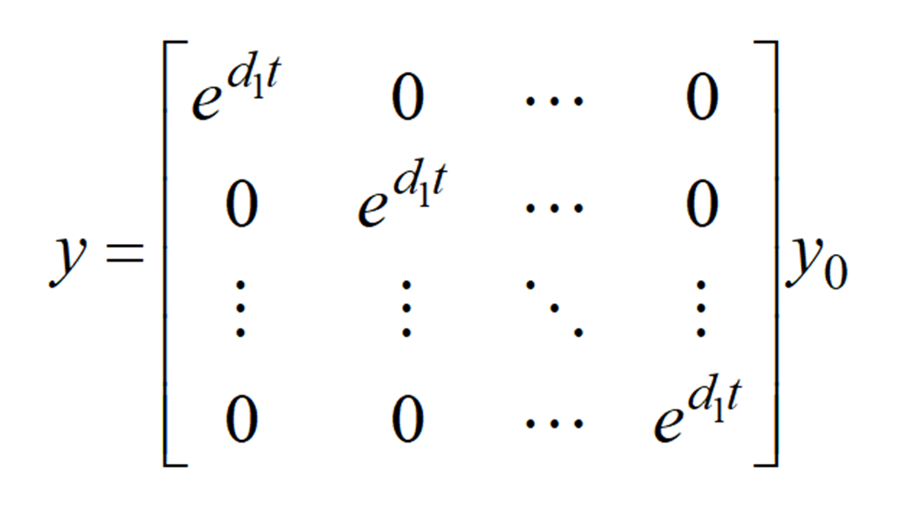
Solution for an ODE
Control Theory (Linear Control)
Slide 11

Slide 12
The End
Do you have any questions?

